Slide 1
Image Enhancement in Frequency Domain
邸慧军
ajon@bit.edu.cn
计算机学院
智能信息技术北京市重点实验室
图像计算与感知智能研究所

Slide 2
Content
Frequency Domain
Fourier Transform
DCT (Discrete Cosine Transformation)
Wavelet
etc.
Image Filter in Frequency Domain
Lowpass filters
Highpass filters
Bandreject/BandPass filters
Homomorphic filtering

Slide 3
Fourier Transform
1D Fourier Transform
2D Fourier Transform

Slide 4
Fourier Transform
We want to understand the frequency ω of our signal. So, let’s reparametrize the signal by ω instead of x:
f(x)
Fourier
Transform
F(ω)
We can always go back:
F(ω)
Inverse Fourier
Transform
f(x)

Slide 5

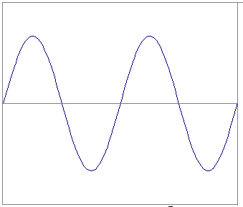
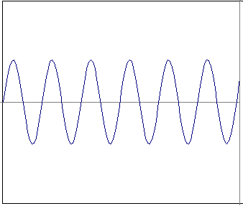
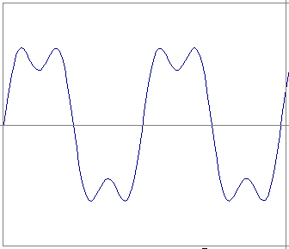
Frequency Spectra
=
+
=

Slide 6
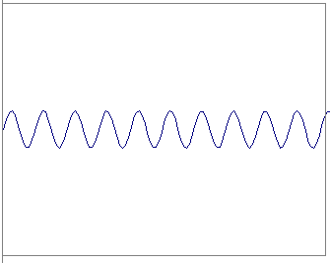
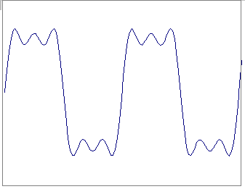
Frequency Spectra
=
+
=

Slide 7
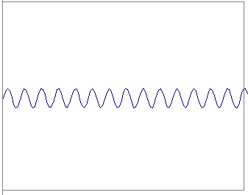
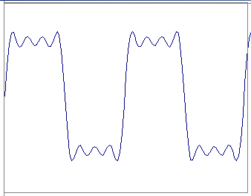
Frequency Spectra
=
+
=

Slide 8
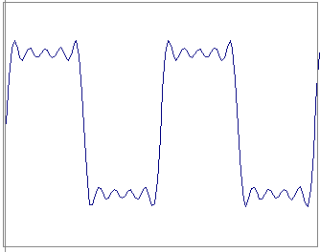
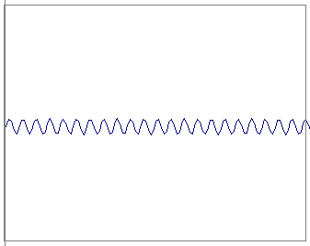
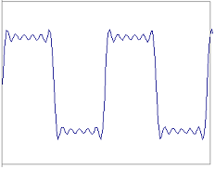
Frequency Spectra
=
+
=

Slide 9
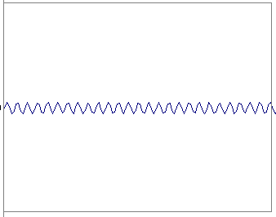
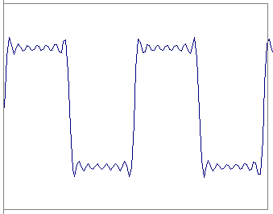
Frequency Spectra
=
+
=

Slide 10
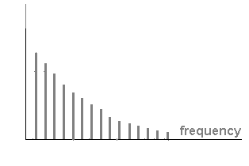
Frequency Spectra
=

Slide 11
Fourier Transform
We want to understand the frequency ω of our signal. So, let’s reparametrize the signal by ω instead of x:
f(x)
Fourier
Transform
F(ω)
Magnitude
Phase angle

Slide 12
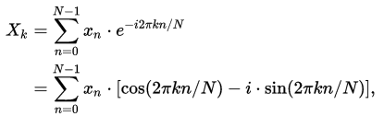
Discrete Fourier Transform
N-periodic

Slide 13
Examples of Fourier Transform
δ(t-a)

Slide 14
Examples of Fourier Transform
Rectangular function

Slide 15
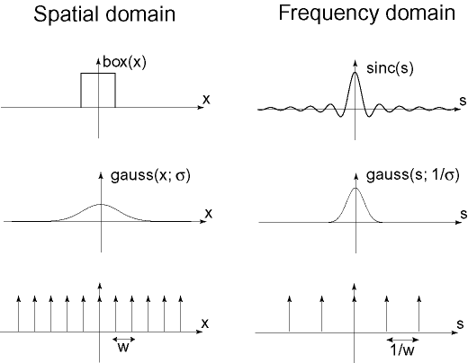

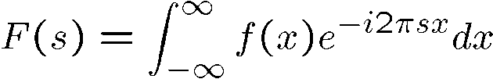
Examples of Fourier Transform

Slide 16
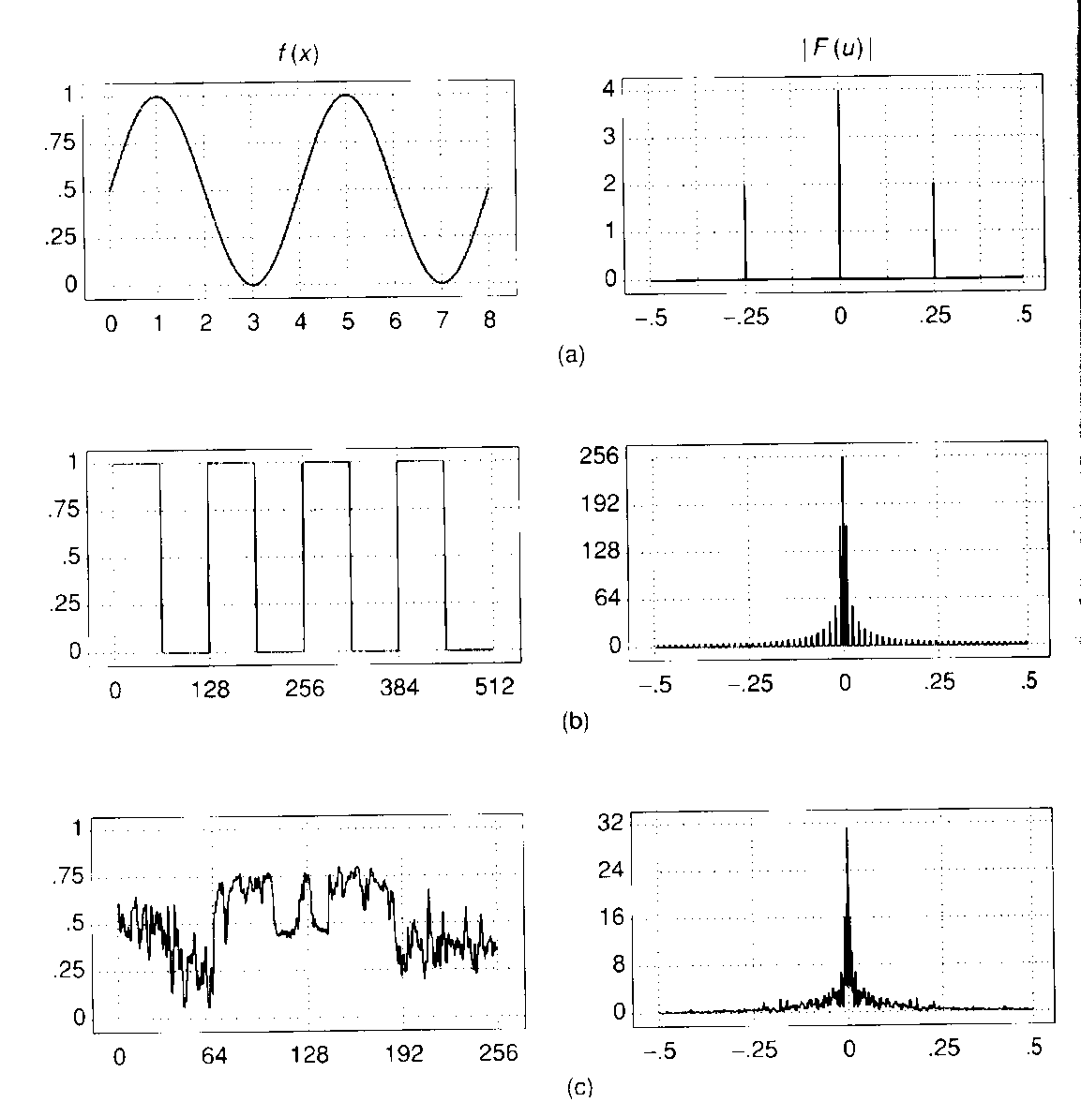
Frequency Spectra

Slide 17
Properties of Fourier Transform
If f(x) is real, F(-ω)=F*(ω)
If f(x) is real, R(ω) even, I(ω) odd
If f(x) is real, f(-x) ➔ F*(ω)
If f(x) is real and even, F(ω) is real and even
If f(x) is real and odd, F(ω) is imaginary and odd

Slide 18
Properties of Fourier Transform
Linearity
Time shifting
Frequency shift
Time scaling

Slide 19
Fourier Transform
1D Fourier Transform
2D Fourier Transform

Slide 20
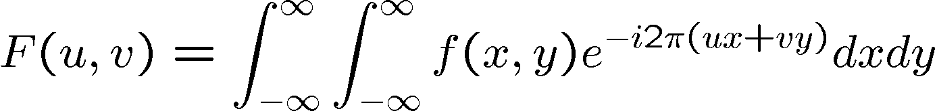
2D Fourier Transform
The Fourier basis uses the family of complex sinusoidal functions

Slide 21
2D DFT
Forward 2D DFT
Inverse 2D DFT
(u, v) are the frequency coordinates while (x, y) are the spatial coordinates
M, N are the number of spatial pixels along the x, y coordinates

Slide 22
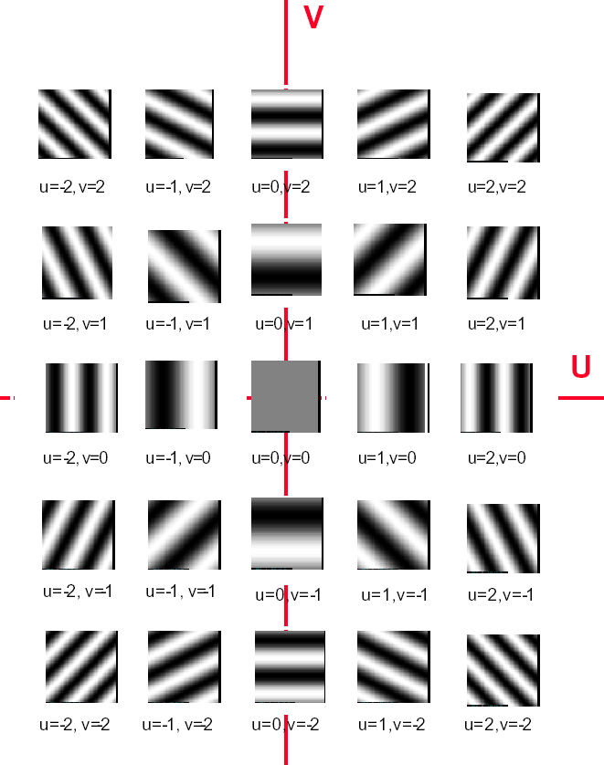







Fourier Basis
Real
(cos) part
(u, v)
(1, 0)
(1, 1)
(0, 5)
Imaginary
(sin) part
v

Slide 23

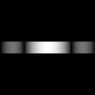
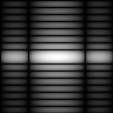
DFT
The 2D DFT F(u,v) can be obtained by
taking the 1D DFT of every row of image f(x,y), F(u,y),
taking the 1D DFT of every column of F(u,y)
(a)f(x,y) (b)F(u,y) (c)F(u,v)

Slide 24
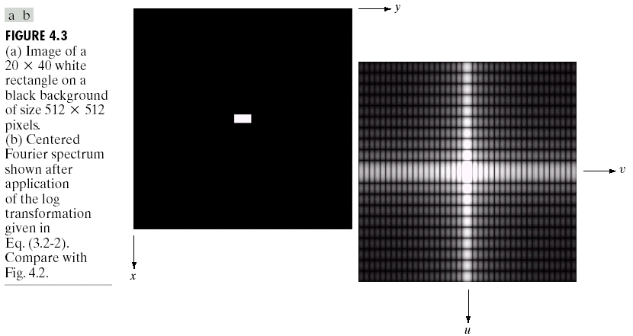
DFT
shift

Slide 25
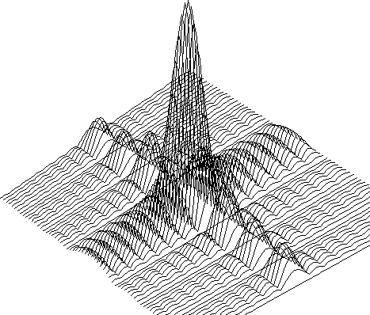
DFT

Slide 26

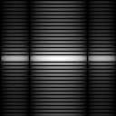

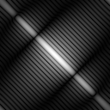
DFT
DFT
DFT

Slide 27

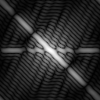
DFT
A
DFT
B
DFT
0.25 * A
+ 0.75 * B
DFT

Slide 28


DFT
Sine wave
Its DFT
2D Gaussian
function
Its DFT

Slide 29
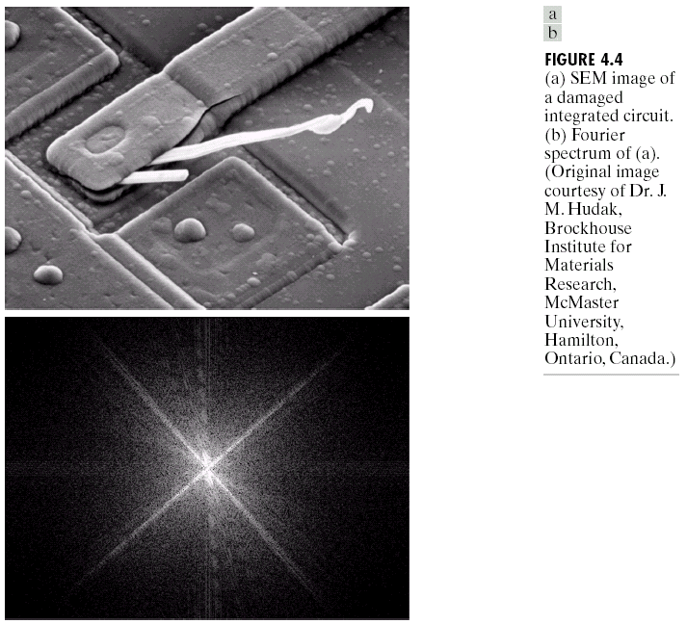
DFT

Slide 30
Content
Frequency Domain
Image Filter in Frequency Domain
Lowpass filters
Highpass filters
Bandreject/BandPass filters
Homomorphic filtering

Slide 31

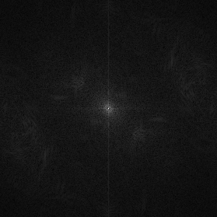


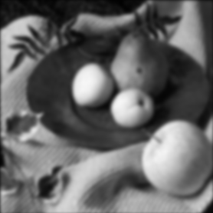

Gaussian Smoothing
f(x,y)
|F(s_{x},s_{y})|
*
h(x,y)
|H(s_{x},s_{y})|
g(x,y)
|G(s_{x},s_{y})|

Slide 32
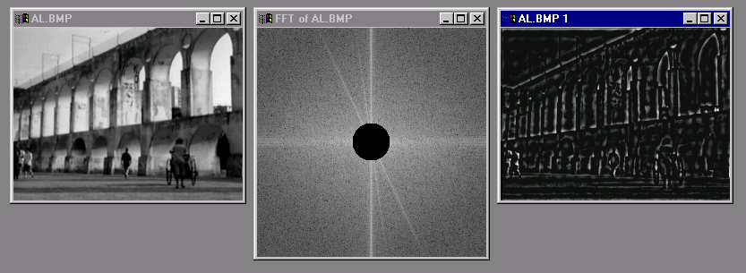
Image Gradient

Slide 33
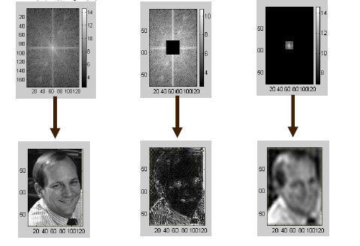
Image Filtering via Fourier Transform
2
Filtering in Frequency domain
1 DFT
3 IDFT

Slide 34
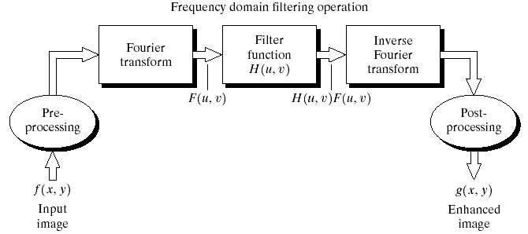
Filtering in the Frequency Domain
Filtering in the frequency domain consists of the following steps:
1. Compute F(u, v), the DFT of the image.
2. Multiply F(u, v) by a filter function H(u, v).
3. Computer the inverse DFT of the result in (2).
4. Computer the real part of the result in (3).

Slide 35

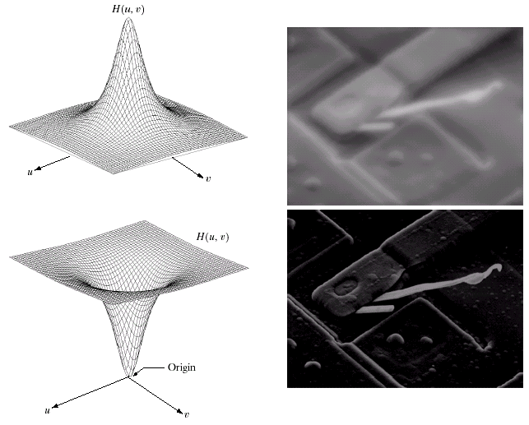
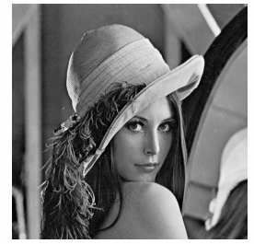

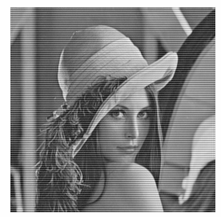
Some basic filters
Lowpass filter
Highpass filter
Selective filter
Lowpass Filter
Highpass Filter

Slide 36
Content
Frequency Domain
Image Filter in Frequency Domain
Lowpass filters
Ideal Lowpass Filters (ILPF)
Butterworth Lowpass Filter (BLPF)
Gaussian Lowpass Filters (GLPF)
Highpass filters
Bandreject/BandPass filters
Homomorphic filtering

Slide 37
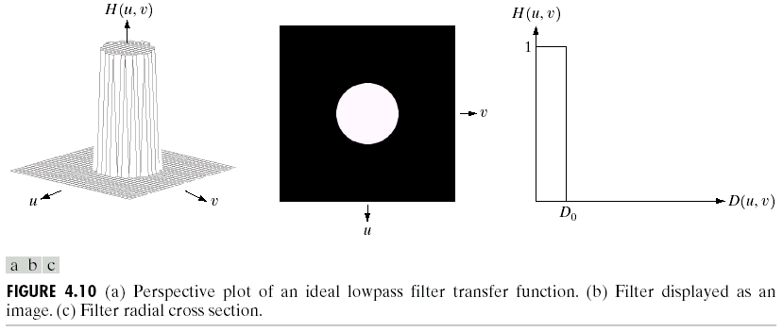
Ideal Lowpass Filters (ILPF)
D₀ is also called cutoff frequency.
where D₀ is a nonnegative constant, and D(u, v) is the distance from the origin.
If the image size is M×N, then

Slide 38
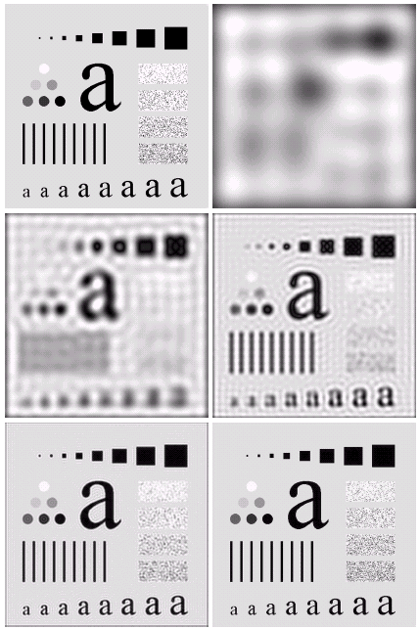
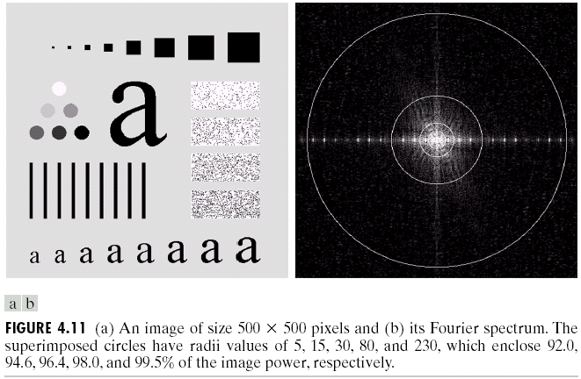

The blurring and ringing phenomena can be seen, in which ringing behavior is characteristic of ideal filters.

Slide 39
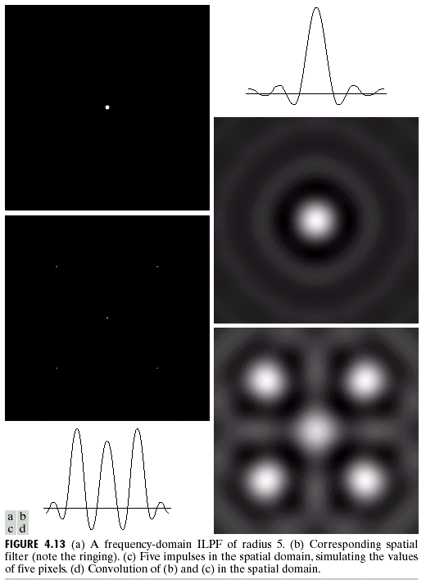
Ringing Effect of ILPF
Frequency
Spatial

Slide 40
Content
Frequency Domain
Image Filter in Frequency Domain
Lowpass filters
Ideal Lowpass Filters (ILPF)
Butterworth Lowpass Filter (BLPF)
Gaussian Lowpass Filters (GLPF)
Highpass filters
Bandreject/BandPass filters
Homomorphic filtering

Slide 41
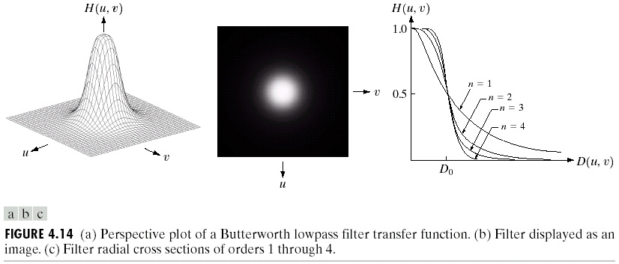
Butterworth Lowpass Filter (BLPF)
The transfer function of a Butterworth lowpass filter of order n , and with cutoff frequency at a distance D0 from the origin, is defined as

Slide 42
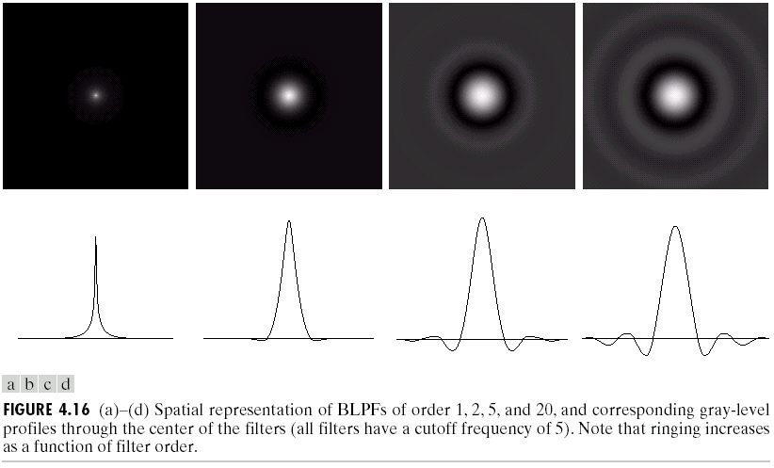
Butterworth Lowpass Filters (BLPF) Spatial Representation
The BLPF may be viewed as a transition between ILPF AND GLPF, BLPF of order 2 is a good compromise between effective lowpass filtering and acceptable ringing characteristics.

Slide 43
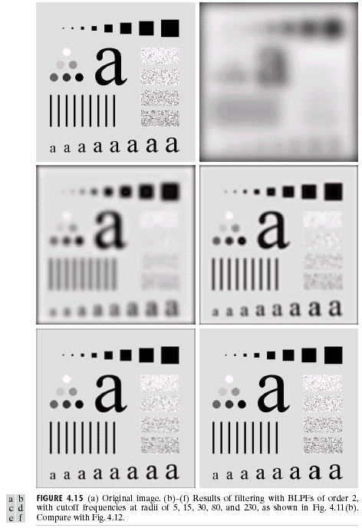
Butterworth Lowpass
Filters (BLPFs)
n=2
D₀=5,15,30,80,and 230
Compared with ILPF,
BLPF does not have a sharp discontinuity.
BLPF makes the image less blurred.

Slide 44

Butterworth Lowpass
Filters (BLPF)

Slide 45
Ideal Lowpass
Filter (ILPF)
ringing phenomena

Slide 46
Content
Frequency Domain
Image Filter in Frequency Domain
Lowpass filters
Ideal Lowpass Filters (ILPF)
Butterworth Lowpass Filter (BLPF)
Gaussian Lowpass Filters (GLPF)
Highpass filters
Bandreject/BandPass filters
Homomorphic filtering

Slide 47
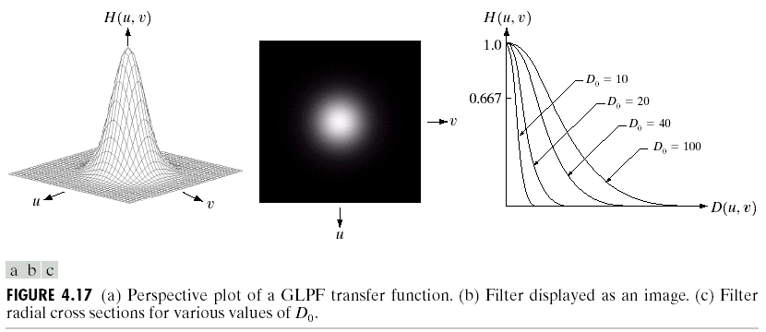
Gaussian Lowpass Filters (GLPF)

Slide 48
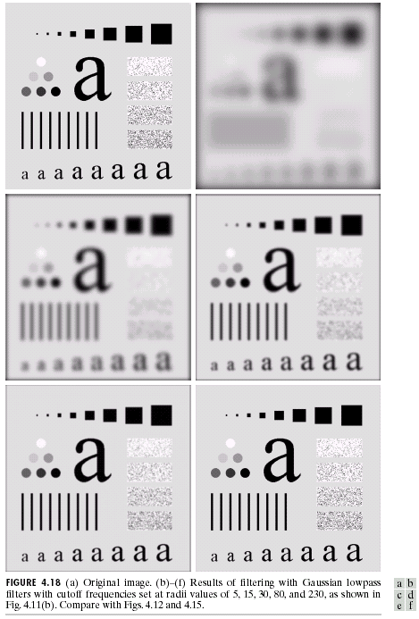
Gaussian Lowpass
Filters (GLPF)
D₀=5,15,30,80,and 230

Slide 49

Contrast of three lowpass filters

Slide 50
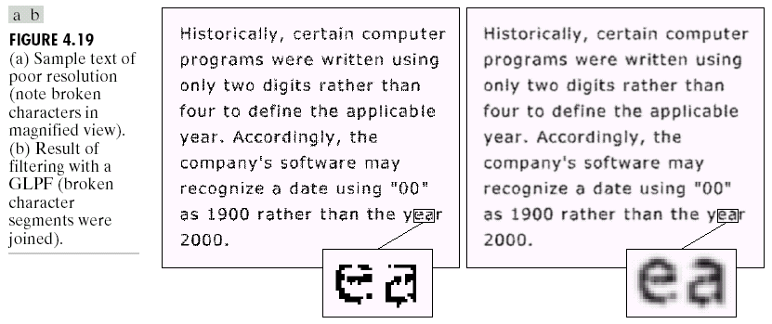
Additional Examples of Lowpass Filtering
Character recognition in machine perception: join the broken character segments with a Gaussian lowpass filter with D₀=80.
--- Smoothing/Blurring
Uses: A lowpass filter is used to connect broken text

Slide 51
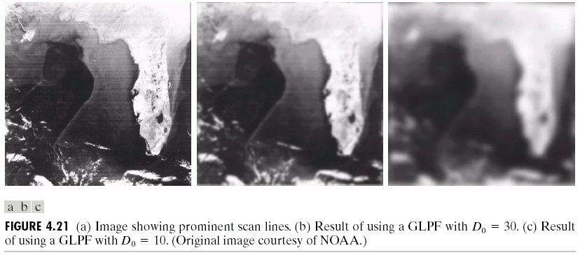
Gaussian lowpass filter for reducing the horizontal sensor scan lines and simplifying the detection of features like the interface boundaries.
--- Smoothing/Blurring

Slide 52
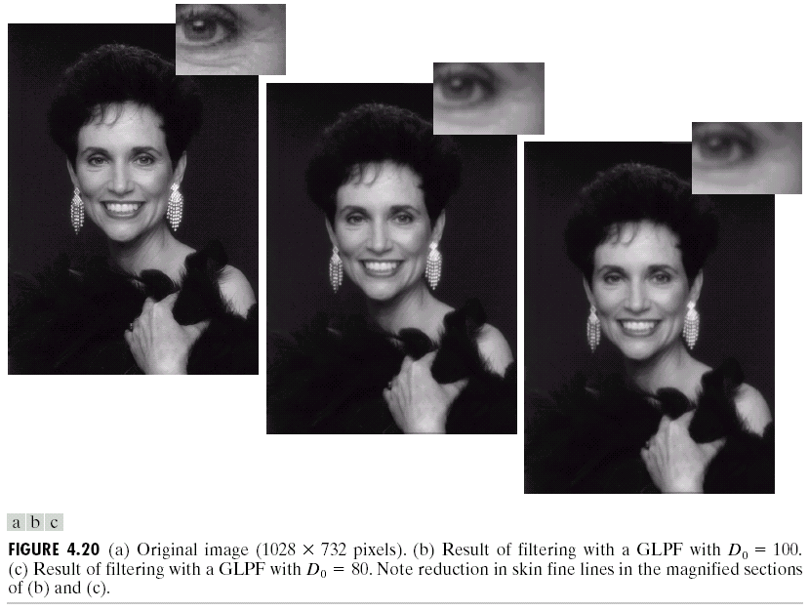
Application in “cosmetic processing” and produce a smoother, softer-looking result from a sharp original.
--- Noise reduction/
Removal of the details

Slide 53
Content
Frequency Domain
Image Filter in Frequency Domain
Lowpass filters
Highpass filters
Ideal Highpass Filters (IHPF)
Butterworth Highpass Filter (BHPF)
Gaussian Highpass Filters (GHPF)
Bandreject/BandPass filters
Homomorphic filtering

Slide 54
Questions
What relationship between the highpass filter and its corresponding lowpass filter?
Ideal Highpass filter
vs.
Ideal Lowpass filter

Slide 55
Highpass Filters
Image sharpening can be achieved in the frequency domain by a high-pass filtering process, which attenuates the low-frequency components without disturbing high-frequency information in the Fourier transform.

Slide 56

Some Basic Filters
Lowpass filter
Highpass filter

Slide 57
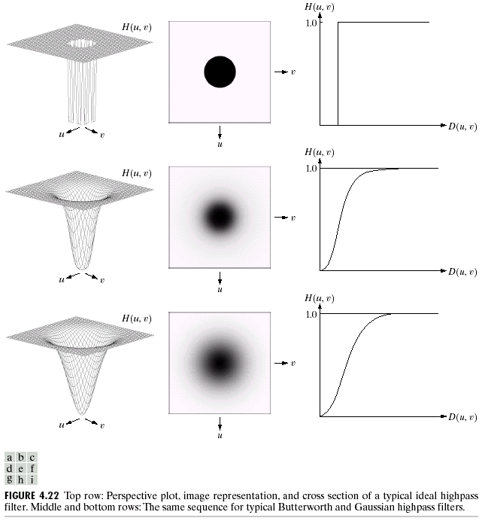
Sharpening Frequency Domain Filters
Ideal highpass filter
Butterworth highpass filter
Gaussian highpass filter

Slide 58
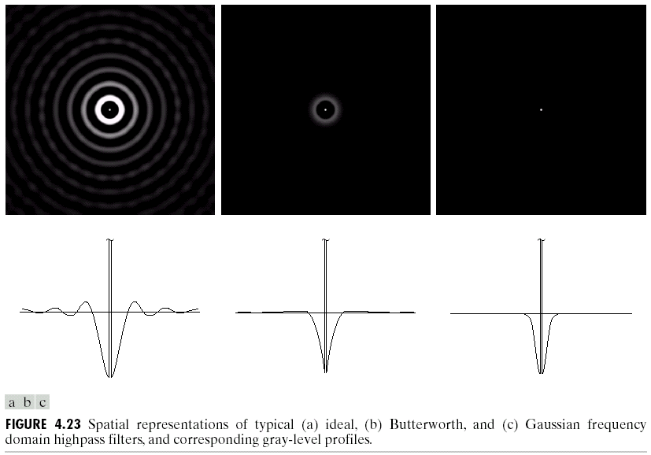
Spatial representation of Ideal, Butterworth and Gaussian highpass filters
Sharpening Frequency Domain Filters

Slide 59
Content
Frequency Domain
Image Filter in Frequency Domain
Lowpass filters
Highpass filters
Ideal Highpass Filters (IHPF)
Butterworth Highpass Filter (BHPF)
Gaussian Highpass Filters (GHPF)
Bandreject/BandPass filters
Homomorphic filtering

Slide 60
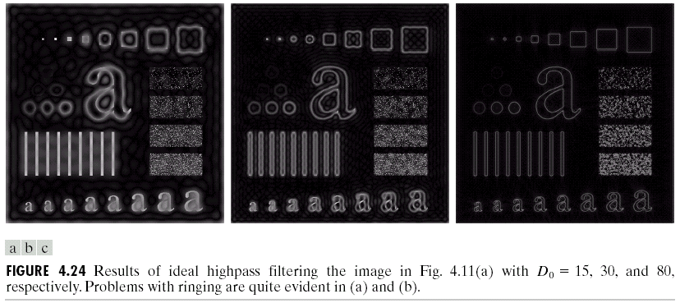
Ideal Highpass Filters
A 2D ideal highpass filter (IHPF) is defined as

Slide 61

Butterworth Highpass filters (BHPF)
The BHPF is given by

Slide 62

Gaussian Highpass Filters (GHPF)

Slide 63

Results Contrast of Ideal, Butterworth and Gaussian highpass filters with D₀ = 15 ,30,80
Sharpening Frequency Domain Filters
ringing properties

Slide 64




highpass filters
Sharpening Frequency Domain Filters
(b) Original Image
(b) IHPFs
(c) BHPFs
(d) GHPFs

Slide 65
Content
Frequency Domain
Image Filter in Frequency Domain
Lowpass filters
Highpass filters
Bandreject/BandPass filters
Ideal Highpass Filters (IHPF)
Butterworth Highpass Filter (BHPF)
Gaussian Highpass Filters (GHPF)
Homomorphic filtering

Slide 66






Bandreject filters
Ideal
Butterworth
Gaussian

Slide 67

Bandreject filters

Slide 68
Content
Frequency Domain
Image Filter in Frequency Domain
Lowpass filters
Highpass filters
Bandreject/BandPass filters
Homomorphic filtering

Slide 69




Homomorphic filtering
Illumination
(low freq.)
reflectance
(high freq.)
ln
Filtering
exp
g
e.g.,

Slide 70

Homomorphic filtering

Slide 71

Homomorphic filtering
before
after

Slide 72
End

